Slide 1
Distributed Computing Systems. TASK
Solution prepared by Section 3, and 4

Slide 2
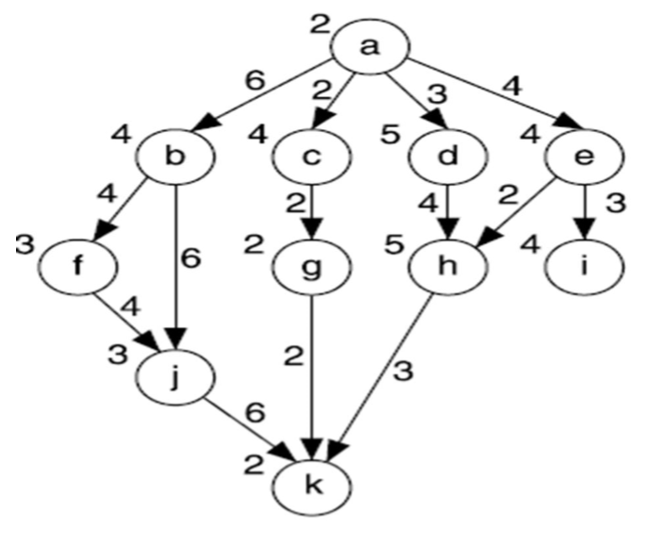
Solve the DAG with Breadth First Algorithm
In three processors

Slide 3
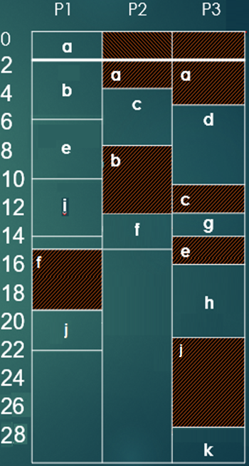
Steps :
1- task (a) assigned to processor 1 .
2- task (b) assigned to processor 1 after task (a).
3- task (c) assigned to p2 after commu. time of task (a)
4- task (d) assigned to p3 after commu. time of task (a)
5- task (e) assigned to p1, no commu. time.
6- task (i) assigned to p1, no commu. time.
7- task (f) assigned to p2 after commu. time of task (b)
8- task (g) assigned to p3 after commu. time of task (c)
9- task (j) assigned to p1 after commu. time of task (f)
10- task (h) assigned to p3 after commu. time of task (e)
12- task (k) assigned to p3 after commu. time of task (j)
So the completion time
= execution time + communication time
= 29 time units

Slide 4
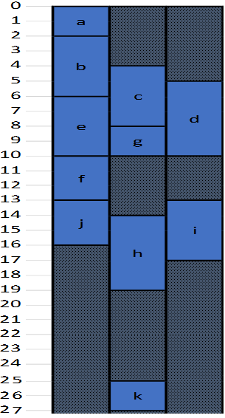
Directed Acyclic Graph and sample task graph
P1 | P2 | P3
Steps

Slide 5
scheduling with communication cost
performed on three processors.
P1 | P2 | P3
steps
Step1: task “a” is assigned to processor “P1”, while P2, P3 are idle.
Step2: task “b” is assigned to P1 after task “a” is executed.
Step3: task “c” is assigned to P2, begins execution after task “a” is executed, plus a communication cost = 2 time units.
Step4: task “d” is assigned to P3, same way to step4, but with communication
time = 3 time units.
Step5: task “e” is assigned to P1, without communication time, as the whole results of task “a” is available at P1.
Step6: task “g” is assigned to P2, without communication time for the same reason.
Step7: same operation when “f” is assigned to processor 1.
Step8: same for task “j”
Step9: task “h” is assigned to P2, it requires results of both “d”, “e” tasks, with communication costs for both of them of 4,2 in sequence, so the overall communication cost both of them is 4 time units.
Step10: task “I” is assigned to P3, requires results from task “e” with communication time = 3 time units.
Step11: task “k” is assigned to P2, requires results from “g”, “h” –already available in P2- and “j” –with communication cost = 6 time units.
The overall execution time = 27 time units

Slide 6

By Using Breadth First Algorithm solve the problem
Executed on three processors

Slide 7
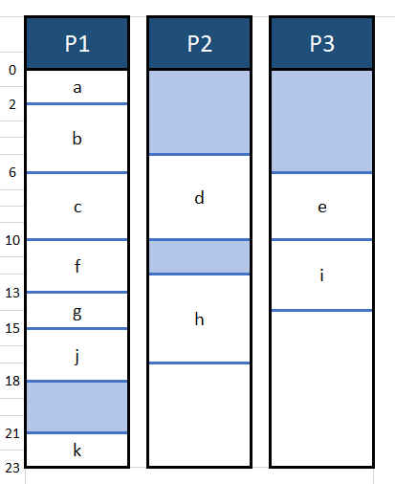
explanation
Task a is assigned to p1, takes 2 time units for execution.
Task b is then assigned to p1, takes 4 time units for execution.
While task d is assigned to p2, which takes 3 time units as communication time, then 5 execution time units.
At the same time, task e is assigned to p3, taking 4 comm time units, then 4 execution time units.
Then task c is assigned to p1 without comm time, as it depends on results of task a which was processed on p1, too.
Same way for task f which depends on task b, g which depends on c, both of them are executed on p1, and task i which depends on e, both of then are executed on p3.
Also task j is dependent on tasks b, and f which were also executed on P1, so there isn’t any communication time.
Task h depends on d, e so it requires 2 comm time units.
Task k depends on j, g –they’re executed on P1- and h ➔ 3 comm time units
Completion time
= execution time + communication time
= 23 time units.

Slide 8

Solve the example by Breadth First Algorithm using 3 processors :

Slide 9
- General Steps of solution :
1. First , we will divide the DAG into levels ( we have 5 levels ) .
2. then , we will put in our minds the dependency of the nodes of the DAG .
3. Finally , we will assign each task to a processor ( but we should put in our minds the execution and communication time ).
4. Try to get the shortest execution time of all the tasks of the DAG ( in this solution we get 24 unit time ) .

Slide 10
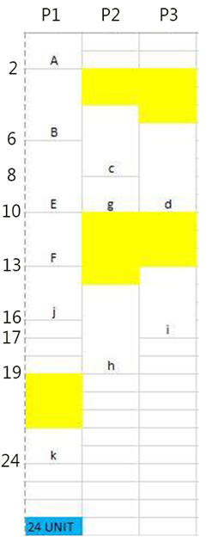
- The solution ( Gantt chart ) :
Completion time
= execution time + communication time
= 24 time units.

Slide 11
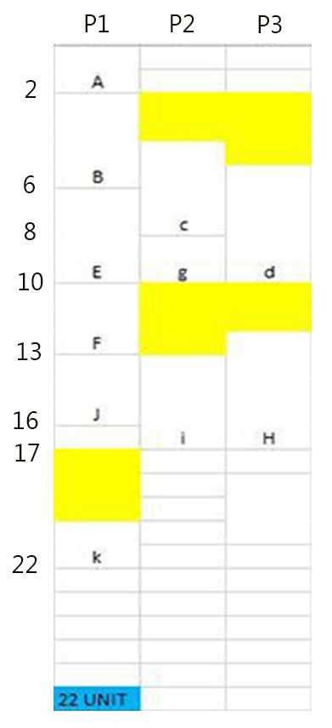
-Another solution ( Gantt chart ) :
Completion time
= execution time + communication time
= 22 time units.

Slide 12
Thanks
Any questions ??

